Slide 1
DITA Workshop
Topics and hierarchy 2.

Slide 2
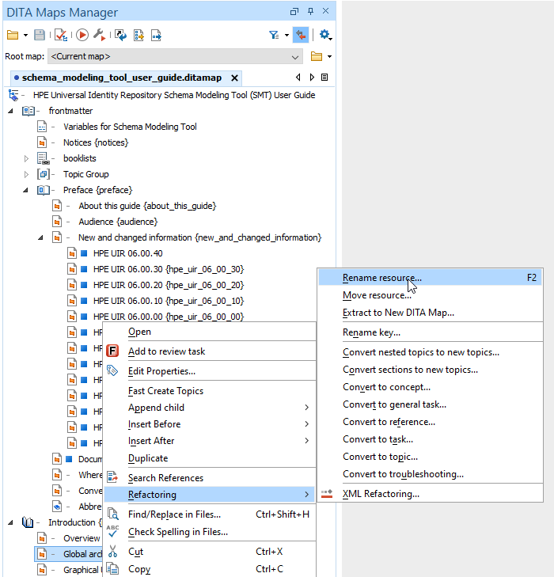
Rename key - Refactoring
Refactoring submenu
Rename resource - Allows you to change the name of a resource linked in the edited DITA map.
Move resource - Allows you to change the location on disk of a resource linked in the edited DITA map. Renaming the resource at the same time is also possible.
Rename Key - Use this operation to rename a key. It also updates all references to it.
XML Refactoring - Opens the XML Refactoring tool wizard that presents refactoring operations to assist you with managing the structure of your XML documents. (Ez szükséges egyáltalán? Nem tűnik túl gyakran használt funkciónak számunkra.)

Slide 3
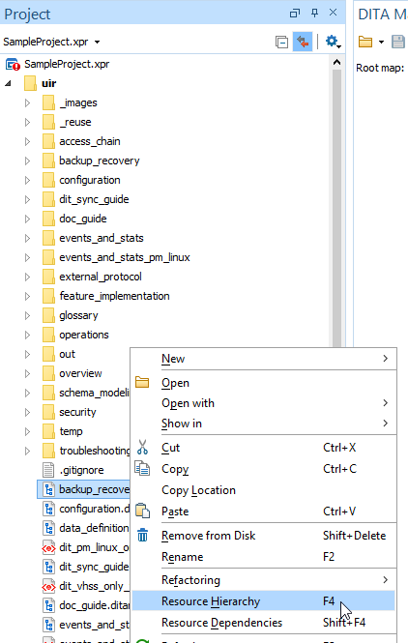
DITA Resource Hierarchy/Dependencies View
The Resource Hierarchy/Dependencies view displays the hierarchy or dependencies for resources included in an XML document. For DITA resources, it will only show direct references, so resources that are indirectly referenced through keys are not presented in the hierarchy or dependencies tree.
To see the hierarchy or dependencies for a DITA resource (maps or topics), right-click a resource in the Project view and either select Resource Hierarchy or Resource Dependencies.

Slide 4
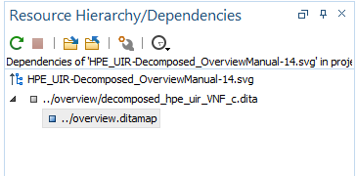
DITA Resource Hierarchy/Dependencies View
If you want to view the dependencies for a media resource (such as images) directly referenced in a DITA topic, click the Show Dependencies button on the toolbar of the Resource Hierarchy/Dependencies view, select the All files filter in the file browser, find the particular resource, and double-click it.

Slide 5
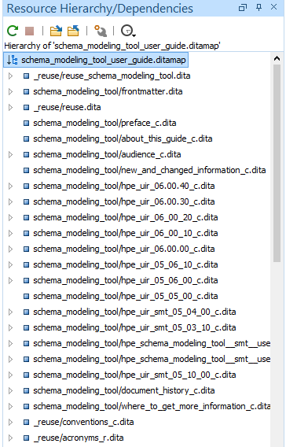
DITA Resource Hierarchy/Dependencies View
Actions
Resource Hierarchy/Dependencies view:
Refresh: Refreshes the Hierarchy/Dependencies structure.
Stop: Stops the hierarchy/dependencies from computing.
Show Hierarchy: Compute the hierarchy structure.
Show Dependencies: Compute the dependencies structure.
Configure dependencies search scope: Allows you to configure a scope to compute the dependencies structure. You can restrict the scope to the current project or to one or multiple working sets.
History: Provides access to the list of previously computed dependencies.

Slide 6
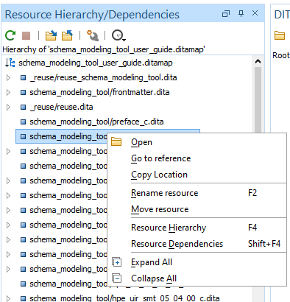
Resource Hierarchy/Dependencies View Contextual menu
Actions Part 1
Open: Opens the resource.
Go to reference: Opens the source document where the resource is referenced.
Copy location: Copies the location of the resource.
Rename resource: Opens the Rename resource dialog box where the following fields are available:
New name
Update references of the renamed resource(s) - As long as Master Files support is enabled, you can select this option to update the references to the resource you are renaming.
Move resource: Opens the Move resource dialog box where the following fields are available:
Destination
New name
Update references of the moved resource(s) - As long as Master Files support is enabled, you can select this option to update the references to the resource you are moving, in accordance with the new location and name.

Slide 7
Resource Hierarchy/Dependencies View Contextual menu
Actions Part 2
Show Resource Hierarchy: Shows the hierarchy for the selected resource.
Show Resource Dependencies: Shows the dependencies for the selected resource.
Expand All: Expands all the children of the selected resource from the Hierarchy/Dependencies structure.
Collapse All: Collapses all children of the selected resource from the Hierarchy/Dependencies structure.

Slide 8
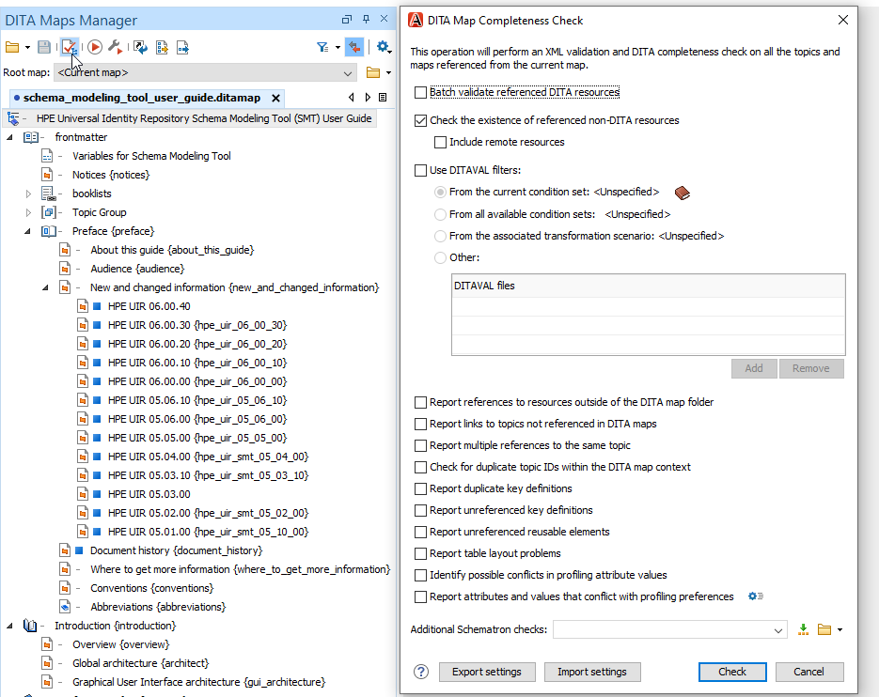
Validate and check for completeness
You should validate your DITA maps regularly to make sure that your maps and topics are valid, and all of the relationships between them are working.
1. In the DITA Maps Manager view, make sure that the tab that holds your root map is selected and that the Root map selection is set either to the name of your root map or to <current map>.
2. It is a good practice to refresh your DITA map before running the validation process. To do so, select the DITA map in the DITA Maps Manager view and click Reload (F5).
© Copyright 2017 DTC ENTERPRISE – The information contained herein is subject to change without notice.
.8.

Slide 9
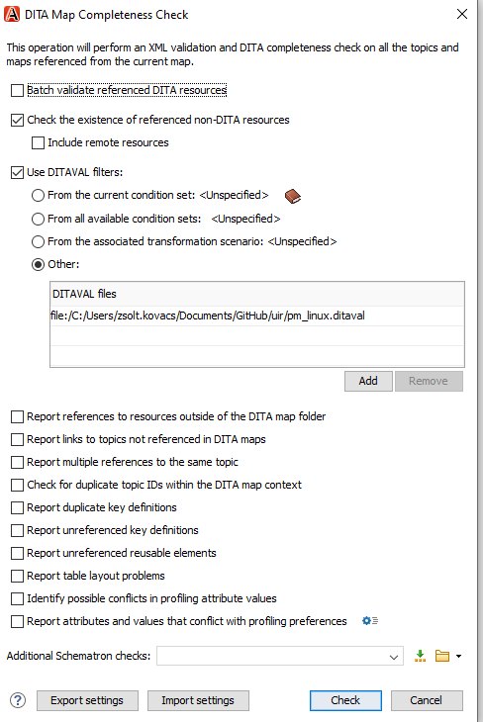
Validate and check for completeness
3. Click the Validate and Check for Completeness button on the DITA Maps Manager toolbar to open the DITA Map Completeness Check dialog box.
4. Click Check to run the validation process.
Important: If you are using profiling, check the Use DITAVAL filters box and select the appropriate option.
© Copyright 2017 DTC ENTERPRISE – The information contained herein is subject to change without notice.
.9.

Slide 10
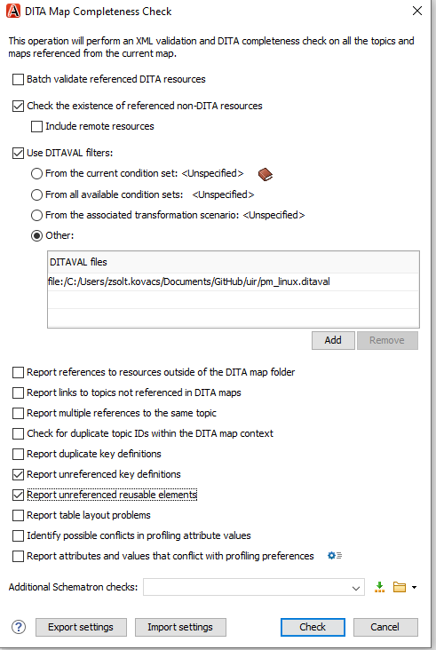
Validate and check for completeness
Report unreferenced key definitions
Checks the entire DITA map and reports any key definitions that are not referenced anywhere.
Note: if the Use DITAVAL filters option is selected, this check will search for unreferenced key definitions based upon your selected filter.
Report unreferenced reusable elements
Checks the entire DITA map and reports any detected reusable elements that are not referenced anywhere. It looks for elements that have an ID specified in the following types of topic references:
Any topicref that contains a processing-role attribute set to resource-only.
Any other referenced topic that contains elements that are reused elsewhere through a conref or conkeyref.
© Copyright 2017 DTC ENTERPRISE – The information contained herein is subject to change without notice.
.10.

Slide 11
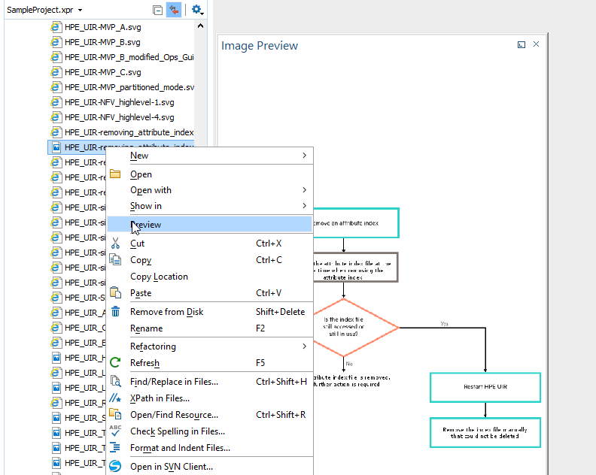
Image Preview from the Project View
Images and SVG files from the Project view can be previewed in a separate panel.
To preview an image, either double-click the image name or click the Preview action from the contextual menu of the Project view. Once the image is displayed in the Preview panel using the actions from the contextual menu, you can scale the image to its original size (1:1 action) or scale it down to fit in the view's available area (Scale to fit action).
To preview an SVG file, click the Preview action from the contextual menu of the Project view. Once the SVG is displayed in the Preview panel, the following actions are available on the contextual menu:
Zoom in
Zoom out
Rotate
Refresh.
You can drag an image from the Image Preview view and drop it in a DITA, DocBook, or TEI document.

Slide 12
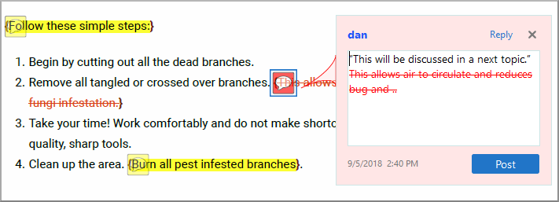
Comments and Tracked Changes
The comments and tracked changes can be made visible in the PDF output by setting the show.changes.and.comments transformation parameter to yes.
By default, they are shown as PDF text annotations (sticky notes). These are graphical markers in the document content and are also listed in the Comments section when opening the output file in Acrobat Reader.
To avoid rendering the elements as PDF annotations and show them as footnotes instead, you can use the show.changes.and.comments.as.pdf.sticky.notes transformation parameter set to no.

Slide 13
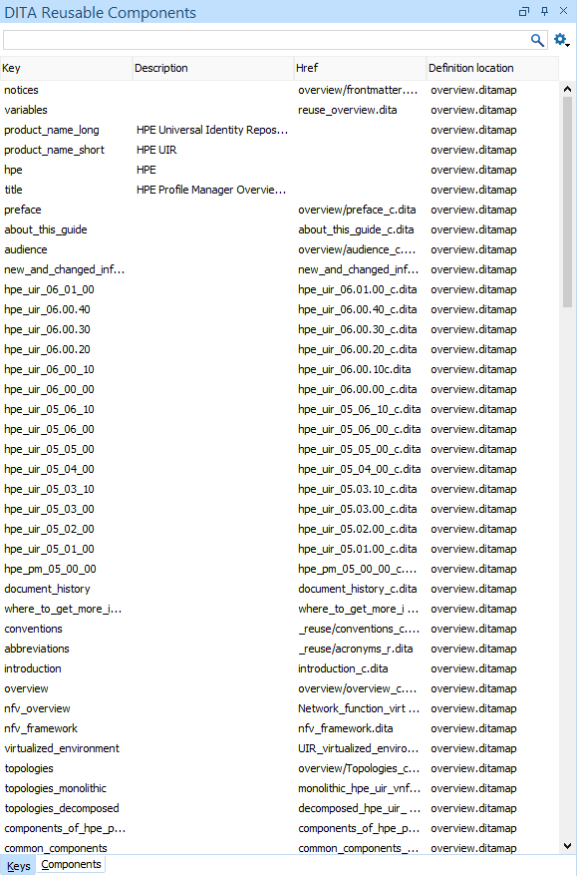
DITA Reusable Components View
Keys Tab
The DITA Reusable Components view is helpful if you use a large amount of keys or reusable components in your DITA project. It collects all the keys and reusable components that are defined in the root map and presents them in a dynamic table where you can easily locate and insert references to them. If the view is not displayed, it can be opened by selecting it from Window > Show View. It includes two tabs:
Keys Tab
The DITA Reusable Components view collects all the keys that are defined in the current root map and provides ways to easily insert references to them as cross reference links, key references, or variables. Keys that are defined with a value have that value listed in the Description column while keys that are defined with an href pointing to their location have that href value listed in the Href column. It includes a search filter field to help you find particular keys, it has several sorting options, and some contextual menu actions.

Slide 14
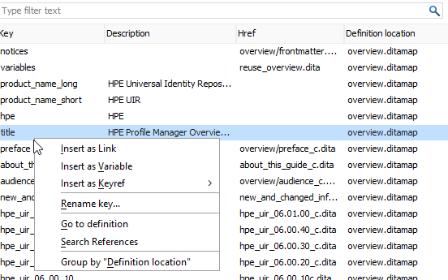
DITA Reusable Components View
Contextual Menu Actions – Keys Tab
Insert as Link - Inserts a cross reference link (xref) to the selected key at the current cursor position or surrounding the current selection.
Insert as Variable - Inserts a variable reference (ph) to the selected key at the current cursor position or surrounding the current selection. However, if the selected key is a reference to an image, this action inserts the key reference in an image element.
Insert as Keyref - Presents a submenu with all the elements that can be inserted at the current cursor position. Selecting an element will insert that element at the current cursor position or surrounding the current selection with a keyref attribute and its value set to the selected key.
Go to Definition - Opens the DITA map where the key is defined.
Group by Definition Location - A toggle action that can be used to group (and sort) all the keys based upon the value in the Definition Location column.

Slide 15
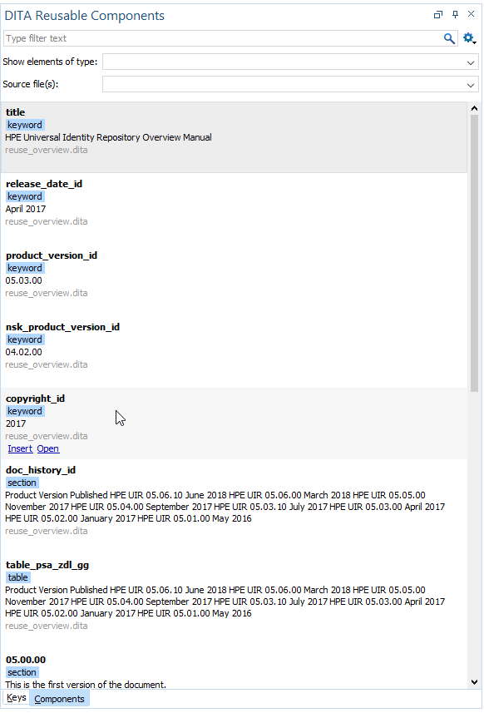
DITA Reusable Components View
Components Tab
Displays all the topics (from the root map) that contain reusable components and provides ways to easily insert them as content references or content key references. To determine which topics to display in this tab, Oxygen XML Editor looks for any topicref in the root map that is marked as resource-only.
<topicref href="topics/randomize-xml-content.dita" processing-role="resource-only"/>
Hover and Click Actions
If you hover over a component shown in the preview window, you have access to the following link actions:
Insert - Inserts the component as a content reference or content key reference at the current cursor position or replaces the current selection. If the parent topic has a key defined, it is inserted as a content key reference (conkeyref). Otherwise, it is inserted as a content reference (conref).
Open - Opens the source file that contains the reusable component.

Slide 16
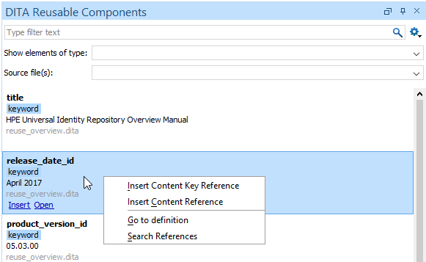
DITA Reusable Components View
Contextual Menu Actions – Components Tab
Insert Content Reference - Inserts the component as a content reference (conref) at the current cursor position or replaces the current selection.
Insert Content Key Reference - Inserts the component as a content key reference (conkeyref) at the current cursor position or replaces the current selection. This action is only available if the parent topic has a key defined.
Go to Definition - Opens the source file that contains the reusable component.

Slide 17
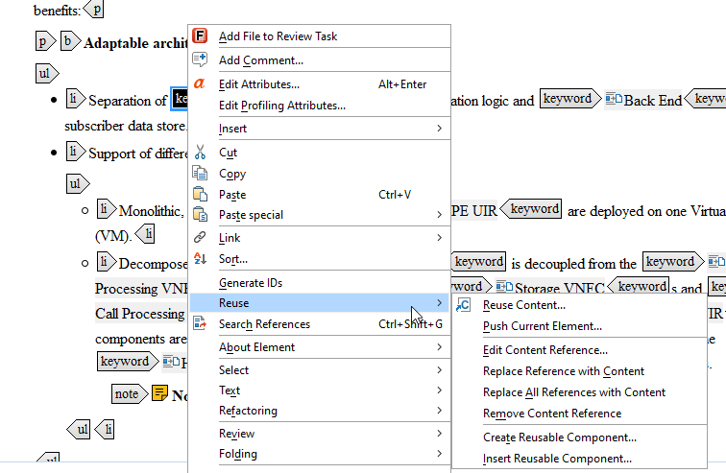
Editing DITA content references
Reuse submenu
Oxygen XML Editor also includes some actions that allows you to quickly edit existing content references. When the element that contains a content reference (conref or conkeyref) is selected, the following actions are available in the DITA menu and the Reuse submenu of the contextual menu:
Edit Content Reference - This action is available for elements with a conref or conkeyref attribute
Replace Reference with content - Replaces the referenced fragment (conref or conkeyref) at the cursor position with its content. This action is useful if you want to make changes to the content in the currently edited document without changing the referenced fragment in its source location.
Remove Content Reference - Removes the content reference (conref or conkeyref) inside the element at the cursor position.

Slide 18
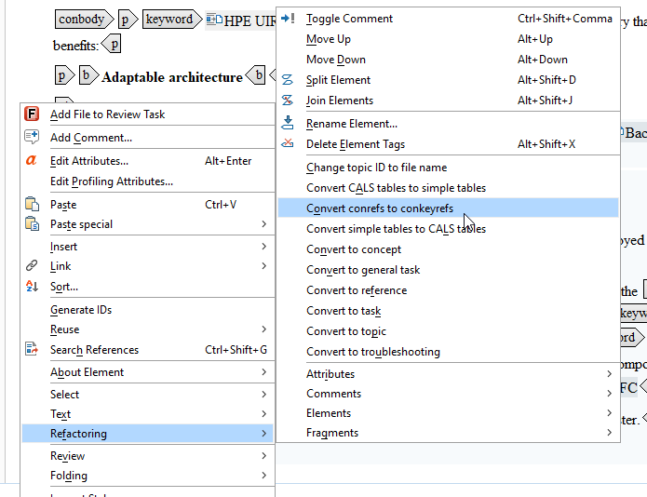
Editing DITA content references
Converting Conrefs to Conkeyrefs
Oxygen XML Editor includes a DITA refactoring operation called Convert conrefs to conkeyrefs that will find all content references and convert them to content key references. To access the Convert conrefs to conkeyrefs operation, use one of the following methods:
Single Document Method
With the document open in the editor, right-click anywhere in the main editing pane (or right-click the topic reference in the DITA Maps Manager), go to the Refactoring submenu, and choose Convert conrefs to conkeyrefs.
Multiple Documents At Once Method
Select XML Refactoring from the Tools menu (or from the Refactoring submenu when you right-click a document in the Project view or the DITA Maps Manager view). Then select Convert conrefs to conkeyrefs from the DITA section and click Next.

Slide 19
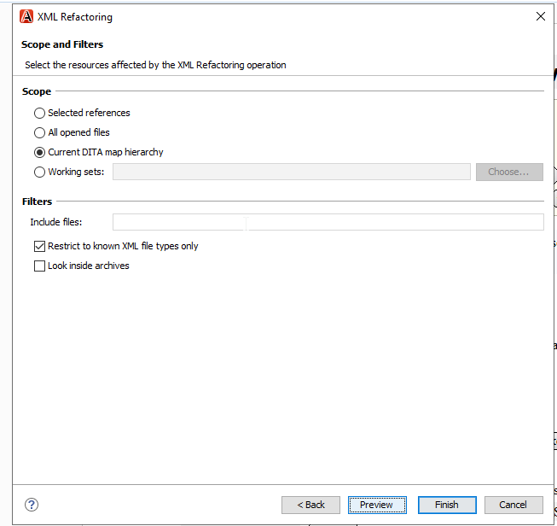
Editing DITA content references
Multiple Documents At Once Method
If you used the Multiple Documents At Once Method, the wizard page allows you to choose a scope for the operation and some filtering options:
Scope - Select from a variety of options to define the scope for which resources will be affected by the operation.
Filters section
Include files - Specifies files to be excluded from the operation. You can specify multiple files by separating them with commas and the patterns can include wildcards (such as * or ?).
Restrict to known XML file types only - Excludes non-XML file types from the operation.
Look inside archives - If this option is selected, the scope of the operation will include files inside archives.

